Slide 1
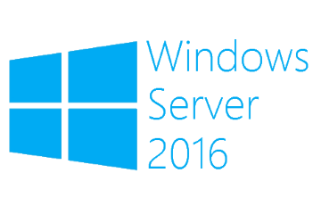
Basic Hyper-V configuration
Megaseries

Slide 2
What will be covered
Hyper-V host configuration
Virtual switch creation
Virtual machine creation
Virtual machine deletion
Setting different virtual machine settings
Create, assign and delete virtual disks

Slide 3

https://www.youtube.com/channel/UCcZ-jLbPwNr8E_v9-65n8Iw https://github.com/itknowledge4

